Slide 1


Slide 2
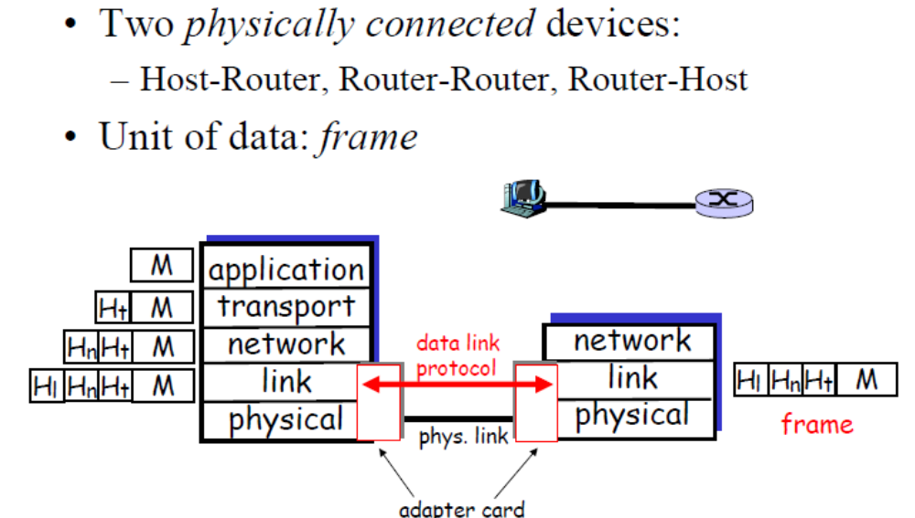
Data Link Layer

Slide 3
Data Link Control Protocols
need layer of logic above Physical
to manage exchange of data over a link
  frame synchronization
  flow control
  error control
  addressing
  control and data
  link management
Notes:
In this chapter, we shift our emphasis to that of sending data over a data communications link. To achieve the necessary control, a layer of logic is added above the physical layer, referred to as data link control or a data link control protocol. Some of the requirements and objectives for effective data communication between two directly connected transmitting-receiving stations:
• Frame synchronization: Data are sent in blocks called frames. The beginning and end of each frame must be recognizable.
• Flow control: The sending station must not send frames at a rate faster than the receiving station can absorb them.
• Error control: Bit errors introduced by the transmission system should be corrected.
• Addressing: On a shared link, such as a local area network (LAN), the identity of the two stations involved in a transmission must be specified.
• Control and data on same link: the receiver must be able to distinguish control information from the data being transmitted.
• Link management: Procedures for the management of initiation, maintenance, and termination of a sustained data exchange over a link.

Slide 4
DLC Service Layer
Framing
  Encapsulated packets into frames
  Establishes frame synchronization
Error Detection and Control
  Errors caused by signal attenuation and noise
  Receiver detects presence of errors
    Receiver drops frame
    Receiver requests retransmission (ARQ)
    Receiver corrects error
Flow Control
  Ensuring that the sender does not overwhelm the receiver

Slide 5
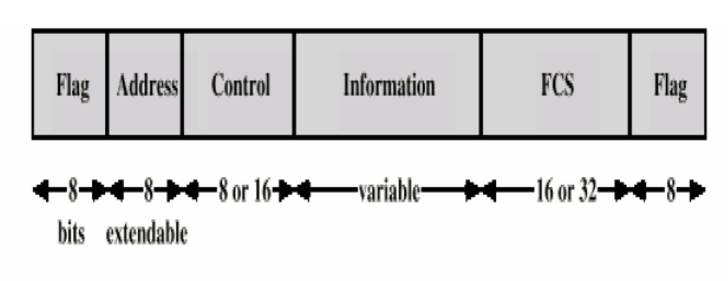
Typical Frame Structure

Slide 6
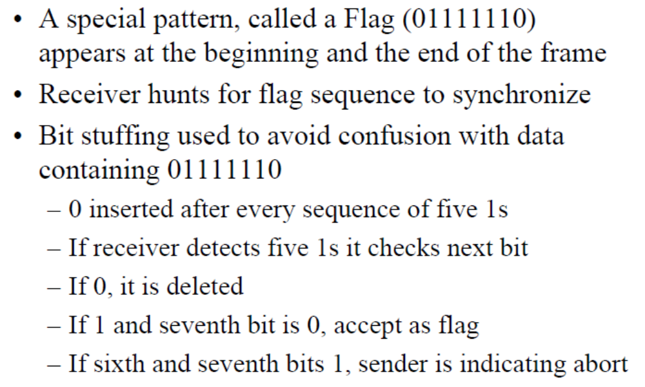
Frame Synchronization

Slide 7
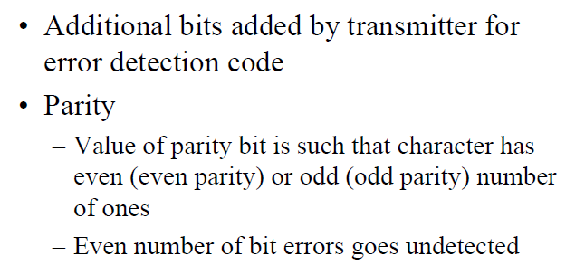

Error Detection

Slide 8
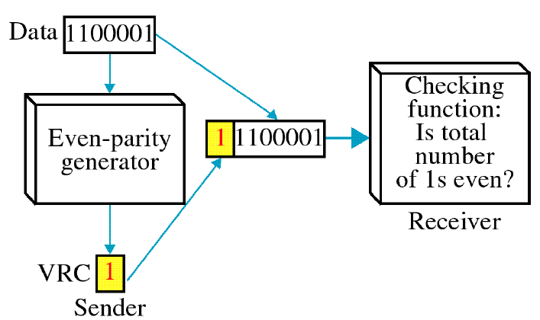
Single Parity Error Checking

Slide 9
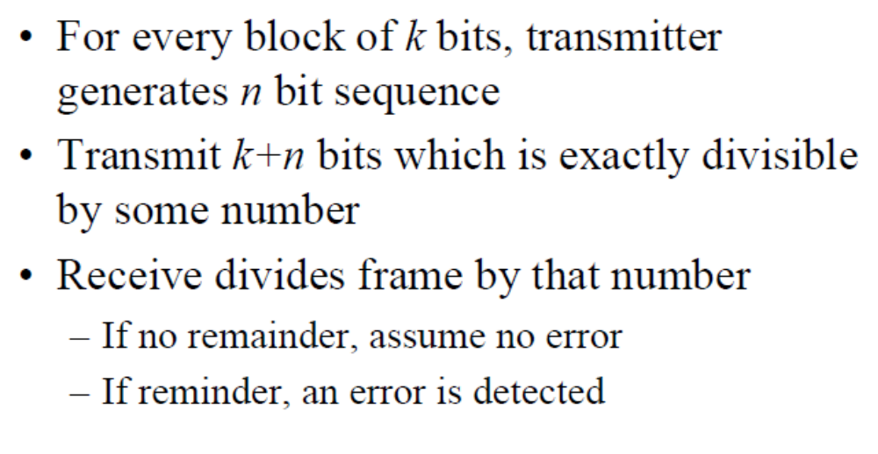
Cyclic Redundancy Check (CRC)

Slide 10
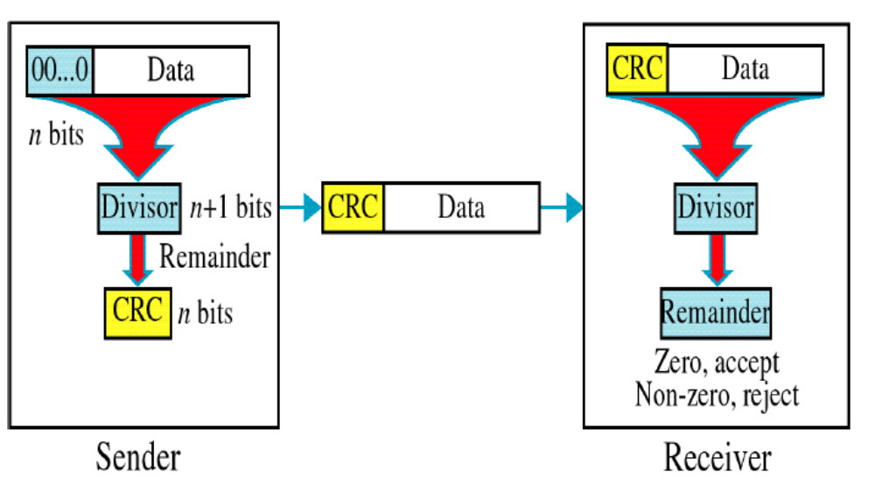
CRC continued..

Slide 11
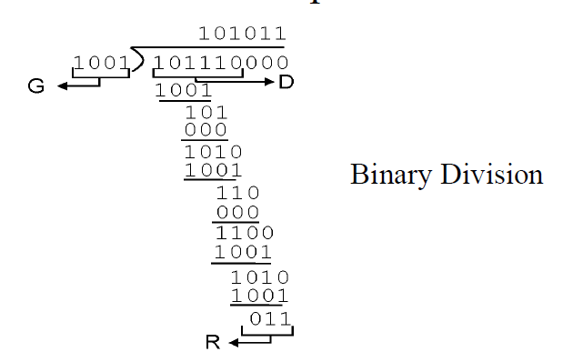
Example..

Slide 12
Flow Control
ensure sending entity does not overwhelm receiving entity
  by preventing buffer overflow
influenced by:
  transmission time
    time taken to emit all bits into medium
  propagation time
    time for a bit to traverse the link
assume here no errors but varying delays
Notes:
Flow control is a technique for assuring that a transmitting entity does not overwhelm a receiving entity with data. The receiving entity typically allocates a data buffer of some maximum length for a transfer. When data are received, the receiver must do a certain amount of processing before passing the data to the higher-level software. In the absence of flow control, the receiver's buffer may fill up and overflow while it is processing old data.
Will assume data sent in a sequence of frames, with each frame containing a portion of the data and some control information. The time it takes for a station to emit all of the bits of a frame onto the medium is the transmission time; this is proportional to the length of the frame. The propagation time is the time it takes for a bit to traverse the link between source and destination. For this section, we assume that all frames that are transmitted are successfully received; no frames are lost, they arrive in order sent, and none arrive with errors. However, each transmitted frame suffers an arbitrary and variable amount of delay before reception.

Slide 13
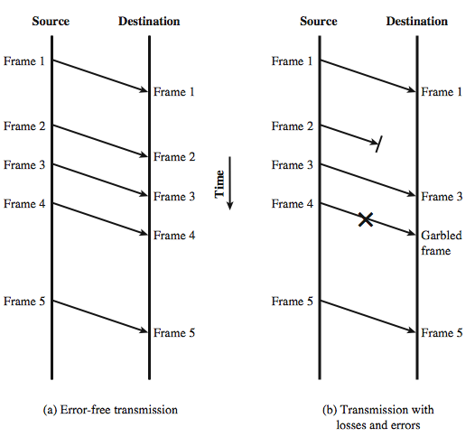
Model of Frame Transmission
Notes:
To start will examine mechanisms for flow control in the absence of errors. The model we will use is depicted in Stallings DCC8e Figure 7.1a, which is a vertical-time sequence diagram. It has the advantages of showing time dependencies and illustrating the correct send-receive relationship. Each arrow represents a single frame transiting a data link between two stations. The data are sent in a sequence of frames, with each frame containing a portion of the data and some control information.

Slide 14
Stop and Wait
source transmits frame
destination receives frame and replies with acknowledgement (ACK)
source waits for ACK before sending next
destination can stop flow by not send ACK
works well for a few large frames
Stop and wait becomes inadequate if large block of data is split into small frames
Notes:
The simplest form of flow control, known as stop-and-wait flow control, works as follows. A source entity transmits a frame. After the destination entity receives the frame, it indicates its willingness to accept another frame by sending back an acknowledgment to the frame just received. The source must wait until it receives the acknowledgment before sending the next frame. The destination can thus stop the flow of data simply by withholding acknowledgment. This procedure works fine and, indeed, can hardly be improved upon when a message is sent in a few large frames. However, it is often the case that a source will break up a large block of data into smaller blocks and transmit the data in many frames (because of limited buffer size, errors detected sooner with less to resend, to prevent media hogging). With the use of multiple frames for a single message, the stop-and-wait procedure may be inadequate, mainly since only one frame at a time can be in transit.

Slide 15
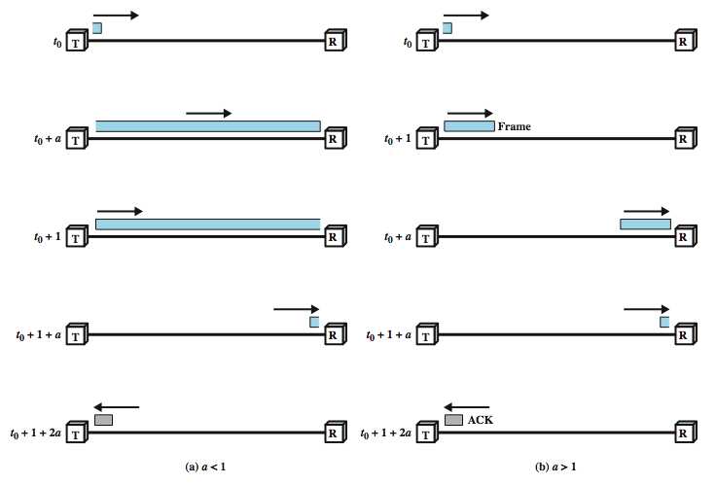
Stop and Wait Link Utilization
Notes:
With the use of multiple frames for a single message, the stop-and-wait procedure may be inadequate, mainly since only one frame at a time can be in transit.
To show this, start by defining the bit length B of a link as the number of bits present on the link at an instance in time when a stream of bits fully occupies the link. In situations where the bit length of the link is greater than the frame length, serious inefficiencies result, as shown in Stallings DCC8e Figure 7.2. In the figure, the transmission time (the time it takes for a station to transmit a frame) is normalized to one, and the propagation delay (the time it takes for a bit to travel from sender to receiver) is expressed as the variable a = B / L (where L is the number of bits in the frame).
When a is less than 1, the propagation time is less than the transmission time. In this case, the frame is sufficiently long that the first bits of the frame have arrived at the destination before the source has completed the transmission of the frame. When a is greater than 1, the propagation time is greater than the transmission time. In this case, the sender completes transmission of the entire frame before the leading bits of that frame arrive at the receiver. Both parts of Figure 7.2 (a and b) consist of a sequence of snapshots, the first four show the process of transmitting a data frame, and the last shows the return of a small acknowledgment frame. Note that for a > 1, the line is always underutilized and even for a < 1, the line is inefficiently utilized. In essence, for very high data rates, for very long distances between sender and receiver, stop-and-wait flow control provides inefficient line utilization.

Slide 16
Sliding Windows Flow Control
allows multiple numbered frames to be in transit
receiver has buffer W long
transmitter sends up to W frames without ACK
ACK includes number of next frame expected
sequence number is bounded by size of field (k)
  frames are numbered modulo 2^{k}
  giving max window size of up to 2^{k} - 1
receiver can ack frames without permitting further transmission (Receive Not Ready)
must send a normal acknowledge to resume
if have full-duplex link, can piggyback ACks
Notes:
The essence of the problem described so far is that only one frame at a time can be in transit. Efficiency can be greatly improved by allowing multiple frames to be in transit at the same time. Consider two stations, A and B, connected via a full-duplex link. Station B allocates buffer space for W frames. Thus, B can accept W frames, and A is allowed to send W frames without waiting for any acknowledgments. To keep track of which frames have been acknowledged, each is labeled with a a k-bit sequence number. This gives a range of sequence numbers of 0 through 2^{k} – 1, and frames are numbered modulo 2^{k}, with a maximum window size of 2^{k} – 1. The window size need not be the maximum possible size for a given sequence number length k. B acknowledges a frame by sending an acknowledgment that includes the sequence number of the next frame expected. This scheme can also be used to acknowledge multiple frames, and is referred to as sliding-window flow control. Most data link control protocols also allow a station to cut off the flow of frames from the other side by sending a Receive Not Ready (RNR) message, which acknowledges former frames but forbids transfer of future frames. At some subsequent point, the station must send a normal acknowledgment to reopen the window. If two stations exchange data, each needs to maintain two windows, one for transmit and one for receive, and each side needs to send the data and acknowledgments to the other. To provide efficient support for this requirement, a feature known as piggybacking is typically provided. Each data frame includes a field that holds the sequence number of that frame plus a field that holds the sequence number used for acknowledgment.

Slide 17
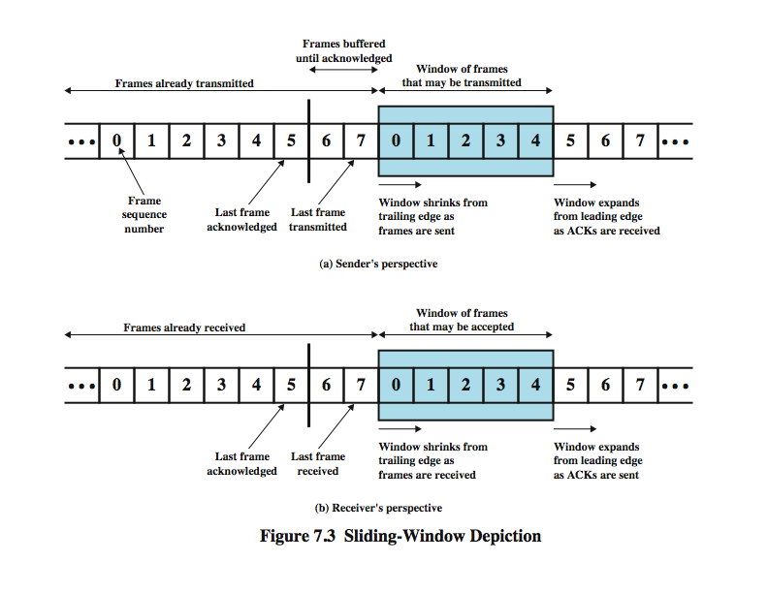
Sliding Window Diagram
Notes:
Stallings DCC8e Figure 7.3 depicts the sliding-window process. It assumes the use of a 3-bit sequence number, so that frames are numbered sequentially from 0 through 7, and then the same numbers are reused for subsequent frames. The shaded rectangle indicates the frames that may be sent; in this figure, the sender may transmit five frames, beginning with frame 0. Each time a frame is sent, the shaded window shrinks; each time an acknowledgment is received, the shaded window grows. Frames between the vertical bar and the shaded window have been sent but not yet acknowledged. As we shall see, the sender must buffer these frames in case they need to be retransmitted.
Sliding-window flow control is potentially much more efficient than stop-and-wait flow control. The reason is that, with sliding-window flow control, the transmission link is treated as a pipeline that may be filled with frames in transit. In contrast, with stop-and-wait flow control, only one frame may be in the pipe at a time.

Slide 18
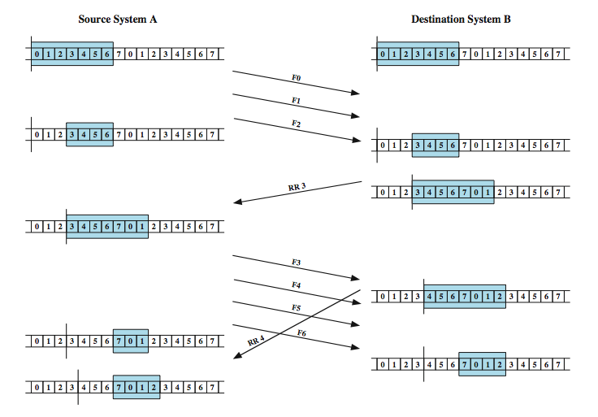
Sliding Window Example
Notes:
An example is shown in Stallings DCC8e Figure 7.4. The example assumes a 3-bit sequence number field and a maximum window size of seven frames. Initially, A and B have windows indicating that A may transmit seven frames, beginning with frame 0 (F0). After transmitting three frames (F0, F1, F2) without acknowledgment, A has shrunk its window to four frames and maintains a copy of the three transmitted frames. The window indicates that A may transmit four frames, beginning with frame number 3. B then transmits an RR (receive ready) 3, which means "I have received all frames up through frame number 2 and am ready to receive frame number 3; in fact, I am prepared to receive seven frames, beginning with frame number 3." With this acknowledgment, A is back up to permission to transmit seven frames, still beginning with frame 3; also A may discard the buffered frames that have now been acknowledged. A proceeds to transmit frames 3, 4, 5, and 6. B returns RR 4, which acknowledges F3, and allows transmission of F4 through the next instance of F2. By the time this RR reaches A, it has already transmitted F4, F5, and F6, and therefore A may only open its window to permit sending four frames beginning with F7.

Slide 19
Error Control
detection and correction of errors such as:
  lost frames
  damaged frames
common techniques used:
  error detection
  positive acknowledgment
  retransmission after timeout
  negative acknowledgement & retransmission
  Collectively these techniques are referred to as Automatic Repeat Request (ARQ)
Notes:
Error control refers to mechanisms to detect and correct errors that occur in the transmission of frames. The model that we will use, which covers the typical case, was illustrated earlier in Figure 7.1b. As before, data are sent as a sequence of frames; frames arrive in the same order in which they are sent; and each transmitted frame suffers an arbitrary and potentially variable amount of delay before reception. In addition, we admit the possibility of two types of errors:
• Lost frame: frame fails to arrive at the other side, eg. because a noise burst damaged a frame so badly it is not recognized
• Damaged frame: A recognizable frame does arrive, but some of the bits are in error (have been altered during transmission).
The most common techniques for error control are based on some or all of the following ingredients:
• Error detection: As discussed in the Chapter 6.
• Positive acknowledgment: The destination returns a positive acknowledgment to successfully received, error-free frames.
• Retransmission after timeout: The source retransmits a frame that has not been acknowledged after a predetermined amount of time.
• Negative acknowledgment and retransmission: The destination returns a negative acknowledgment to frames in which an error is detected. The source retransmits such frames.

Slide 20
Automatic Repeat Request (ARQ)
collective name for such error control mechanisms, including:
stop and wait
go back N
selective reject (selective retransmission)
Notes:
Collectively, these mechanisms are all referred to as automatic repeat request (ARQ); the effect of ARQ is to turn an unreliable data link into a reliable one. Three versions of ARQ have been standardized:
Stop-and-wait ARQ
Go-back-N ARQ
Selective-reject ARQ
All of these forms are based on the use of the flow control techniques discussed in Section 7.1. We examine each in turn.

Slide 21
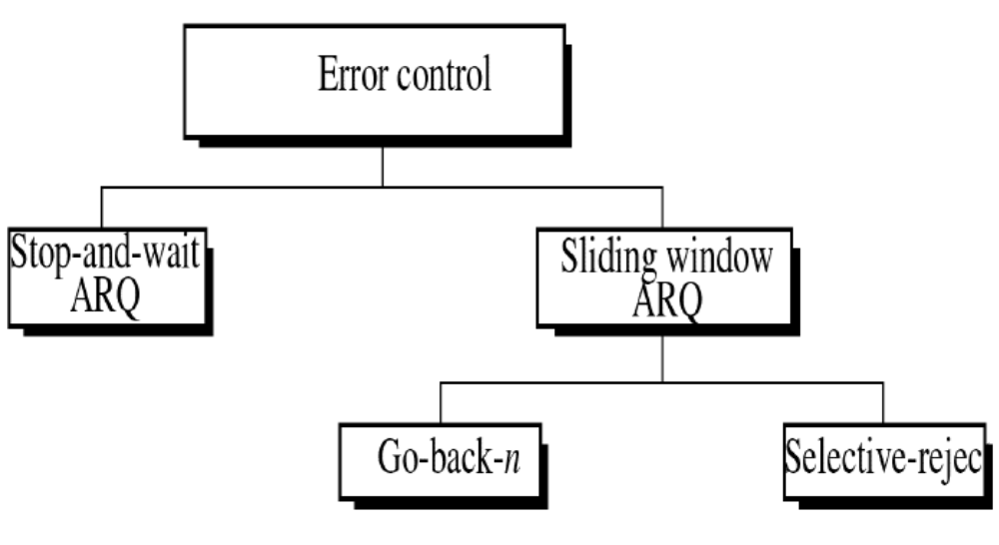
Automatic Repeat Request

Slide 22
Stop and Wait
source transmits single frame
wait for ACK
if received frame damaged, discard it
  transmitter has timeout
  if no ACK within timeout, retransmit
if ACK damaged,transmitter will not recognize it
  transmitter will retransmit
  receive gets two copies of frame
  use alternate numbering and ACK0 / ACK1
Notes:
Stop-and-wait ARQ is based on the stop-and-wait flow control technique outlined previously. The source station transmits a single frame and then must await an acknowledgment (ACK). No other data frames can be sent until the destination station's reply arrives at the source station.
Two sorts of errors could occur. First, the frame that arrives at the destination could be damaged. The receiver detects this by using the error-detection technique referred to earlier and simply discards the frame. To account for this possibility, the source station is equipped with a timer. After a frame is transmitted, the source station waits for an acknowledgment. If no acknowledgment is received by the time that the timer expires, then the same frame is sent again. Note that this method requires that the transmitter maintain a copy of a transmitted frame until an acknowledgment is received for that frame.
The second sort of error is a damaged acknowledgment, which is not recognizable by A, which will therefore time out and resend the same frame. This duplicate frame arrives and is accepted by B. B has therefore accepted two copies of the same frame as if they were separate. To avoid this problem, frames are alternately labeled with 0 or 1, and positive acknowledgments are of the form ACK0 and ACK1. In keeping with the sliding-window convention, an ACK0 acknowledges receipt of a frame numbered 1 and indicates that the receiver is ready for a frame numbered 0.

Slide 23
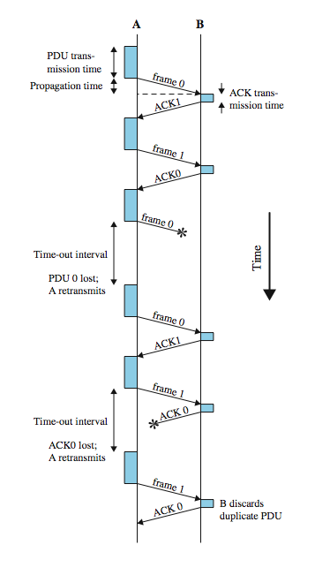
Stop and Wait
see example with both types of errors
pros and cons
  simple
  inefficient
Notes:
Stallings DCC8e Figure 7.5 gives an example of the use of stop-and-wait ARQ, showing the transmission of a sequence of frames from source A to destination B. The figure shows the two types of errors just described. The third frame transmitted by A is lost or damaged and therefore B does not return an ACK. A times out and retransmits the frame. Later, A transmits a frame labeled 1 but the ACK0 for that frame is lost. A times out and retransmits the same frame. When B receives two frames in a row with the same label, it discards the second frame but sends back an ACK0 to each.
The principal advantage of stop-and-wait ARQ is its simplicity. Its principal disadvantage is that stop-and-wait is an inefficient mechanism.

Slide 24
Go Back N
based on sliding window
if no error, ACK as usual
use window to control number of outstanding frames
if error, reply with rejection
  discard that frame and all future frames until error frame received correctly
  transmitter must go back and retransmit that frame and all subsequent frames
Notes:
The sliding-window flow control technique can be adapted to provide more efficient line use, sometimes referred to as continuous ARQ. The form of error control based on sliding-window flow control that is most commonly used is called go-back-N ARQ. In this method, a station may send a series of frames sequentially numbered modulo some maximum value. The number of unacknowledged frames outstanding is determined by window size, using the sliding-window flow control technique. While no errors occur, the destination will acknowledge incoming frames as usual (RR = receive ready, or piggybacked acknowledgment). If the destination station detects an error in a frame, it may send a negative acknowledgment (REJ = reject) for that frame, as explained in the following rules. The destination station will discard that frame and all future incoming frames until the frame in error is correctly received. Thus, the source station, when it receives a REJ, must retransmit the frame in error plus all succeeding frames that were transmitted in the interim.

Slide 25
Go Back N - Handling
Damaged Frame
  error in frame i so receiver rejects frame i
  transmitter retransmits frames from i
Lost Frame
  frame i lost and either
    transmitter sends i+1 and receiver gets frame i+1 out of seq and rejects frame i
    or transmitter times out and send ACK with P bit set which receiver responds to with ACK i
  transmitter then retransmits frames from i
Notes:
Suppose that station A is sending frames to station B. After each transmission, A sets an acknowledgment timer for the frame just transmitted. Suppose that B has previously successfully received frame (i – 1) and A has just transmitted frame i. The go-back-N technique takes into account the following contingencies:
1. Damaged frame.
2. Lost Frame
3. Damaged Ack
4. Damaged Reject

Slide 26
Go Back N - Handling
Damaged Acknowledgement
  receiver gets frame i, sends ack (i+1) which is lost
  acks are cumulative, so next ack (i+n) may arrive before transmitter times out on frame i
  if transmitter times out, it sends ack with P bit set
  can be repeated a number of times before a reset procedure is initiated
Damaged Rejection
  reject for damaged frame is lost
  handled as for lost frame when transmitter times out

Slide 27
Selective Reject
also called selective retransmission
only rejected frames are retransmitted
subsequent frames are accepted by the receiver and buffered
minimizes retransmission
receiver must maintain large enough buffer
more complex logic in transmitter
hence less widely used
useful for satellite links with long propagation delays
Notes:
With selective-reject ARQ, the only frames retransmitted are those that receive a negative acknowledgment, in this case called SREJ, or those that time out. Selective reject would appear to be more efficient than go-back-N, because it minimizes the amount of retransmission. On the other hand, the receiver must maintain a buffer large enough to save post-SREJ frames until the frame in error is retransmitted and must contain logic for reinserting that frame in the proper sequence. The transmitter, too, requires more complex logic to be able to send a frame out of sequence. Because of such complications, select-reject ARQ is much less widely used than go-back-N ARQ. Selective reject is a useful choice for a satellite link because of the long propagation delay involved.

Slide 28
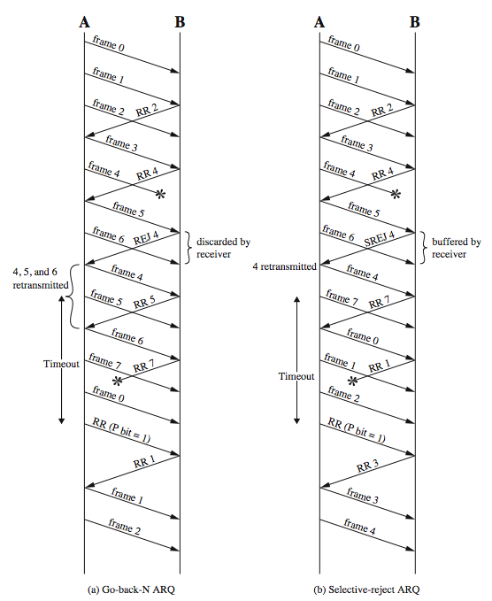
Go Back N vs
Selective Reject
Notes:
Stallings DCC8e Figure 7.6a is an example of the frame flow for go-back-N ARQ. Because of the propagation delay on the line, by the time that an acknowledgment (positive or negative) arrives back at the sending station, it has already sent at least one additional frame beyond the one being acknowledged. In this example, frame 4 is damaged. Frames 5 and 6 are received out of order and are discarded by B. When frame 5 arrives, B immediately sends a REJ 4. When the REJ to frame 4 is received, not only frame 4 but frames 5 and 6 must be retransmitted. Note that the transmitter must keep a copy of all unacknowledged frames. Figure 7.6a also shows an example of retransmission after timeout. No acknowledgment is received for frame 5 within the timeout period, so A issues an RR to determine the status of B.
Stallings DCC8e Figure 7.6b illustrates selective-reject ARQ. When frame 5 is received out of order, B sends a SREJ 4, indicating that frame 4 has not been received. However, B continues to accept incoming frames and buffers them until a valid frame 4 is received. At that point, B can place the frames in the proper order for delivery to higher-layer software.

Slide 29
Summary
introduced need for data link protocols
flow control
error control
Notes:
Chapter 7 summary.

